Slide 1
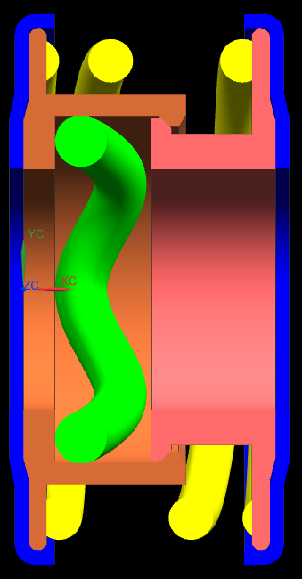
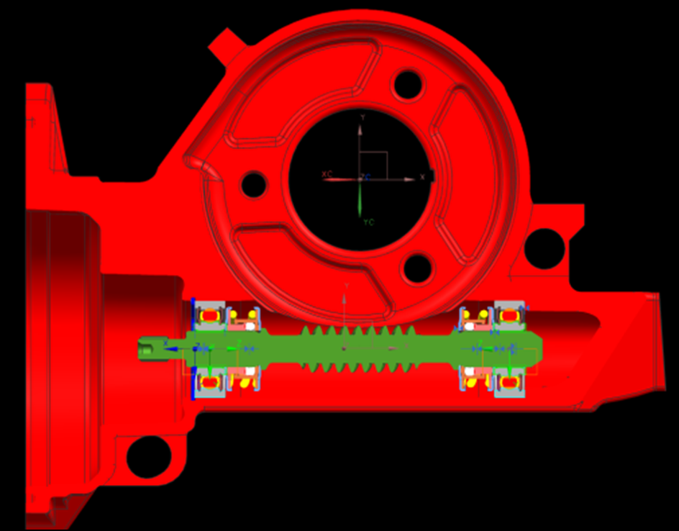
CCM-78: Spring Worm Isolators
Last updated: 24FE16
Description
Implement spring isolators for production
Motivation : 3.0
Deliverables
Fix low temperature reversal clunk issue
Improve robustness (bumper geometry change)
Timing
ASAP
Team Members/Customers
Team names: Brad Sundholm
Customers: Application Teams

Slide 2
CCM-78: Worm Spring Isolators
Last updated: 24FE16
Status Update:
Wave Bumper Spring Isolator
Clearance to OD of bumper fixed bumper stick issue.
Cold clunk issue still present.
Project has been cancelled.
Challenges:
LMC stack low temp reversal clunk issue
Next Actions:
TBD

